Slide 1

BREAST CANCER DETECTION SUBMITTED TO MR.ROHIT AGARWAL SUBMITTED BY TANISHA AGARWAL

Slide 2
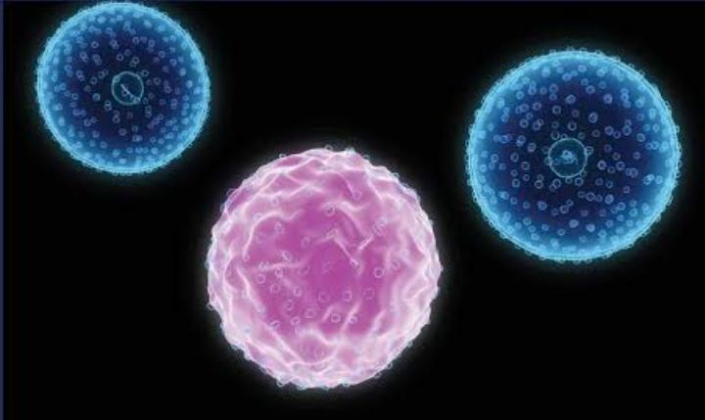
INTRODUCTION
Breast cancer is a dangerous disease for women. If it does not identify in the early-stage then the result will be the death of the patient. It is a common cancer in women worldwide. Worldwide near about 12% of women affected by breast cancer and the number is still increasing.The doctors do not identify each and every breast cancer patient. That’s the reason Machine Learning Engineer / Data Scientist comes into the picture because they have knowledge of maths and computational power. So let’s start……

Slide 3
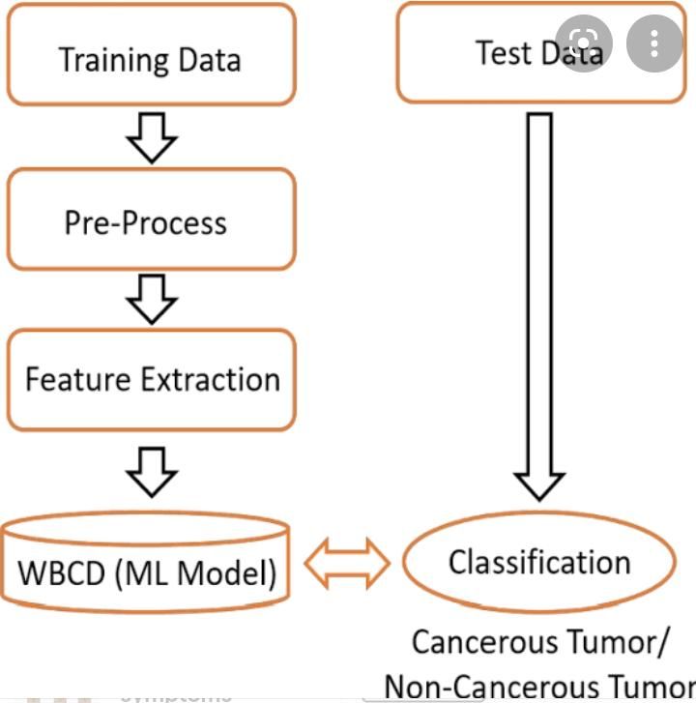
PROCESS OF DETECTION
Follow the “Breast Cancer Detection Using Machine Learning Classifier End to End Project” step by step to get 3 Bonus.
1. Raw Dataset
2. Ready to use Clean Dataset for ML project
3. Full Project in Jupyter Notebook File

Slide 4

1/13/22, 1:35 AM
Untitled3.ipynb - Colaboratory
import pandas as pd import numpy as np
from sklearn.datasets import load_breast_cancer from sklearn.preprocessing import StandardScaler
from keras.models import Sequential from keras.layers import Dense
data = load_breast_cancer() data.keys()
dict_keys(['data', 'target', 'frame', 'target_names', 'DESCR', 'feature_names', 'fil
print(data['DESCR'])
.. _breast_cancer_dataset:
Breast cancer wisconsin (diagnostic) dataset
**Data Set Characteristics:**
:Number of Instances: 569
:Number of Attributes: 30 numeric, predictive attributes and the class
:Attribute Information:
radius (mean of distances from center to points on the perimeter)
texture (standard deviation of gray-scale values)
perimeter
area
smoothness (local variation in radius lengths)
compactness (perimeter^2 / area - 1.0)
concavity (severity of concave portions of the contour)
concave points (number of concave portions of the contour)
symmetry
fractal dimension ("coastline approximation" - 1)
The mean, standard error, and "worst" or largest (mean of the three
worst/largest values) of these features were computed for each image, resulting in 30 features. For instance, field 0 is Mean Radius, field
10 is Radius SE, field 20 is Worst Radius.
class:
WDBC-Malignant
WDBC-Benign
:Summary Statistics:
===================================== ====== ======

Slide 5

1/13/22, 1:35 AM
Untitled3.ipynb - Colaboratory
===================================== | Min ====== | Max ======
radius (mean): | 6.981 | 28.11
texture (mean): | 9.71 | 39.28
perimeter (mean): | 43.79 | 188.5
area (mean): | 143.5 | 2501.0
smoothness (mean): | 0.053 | 0.163
compactness (mean): | 0.019 | 0.345
concavity (mean): | 0.0 | 0.427
concave points (mean): | 0.0 | 0.201
symmetry (mean): | 0.106 | 0.304
fractal dimension (mean): | 0.05 | 0.097
radius (standard error): | 0.112 | 2.873
texture (standard error): | 0.36 | 4.885
perimeter (standard error): | 0.757 | 21.98
area (standard error): | 6.802 | 542.2
smoothness (standard error): | 0.002 | 0.031
compactness (standard error): | 0.002 | 0.135
concavity (standard error): | 0.0 | 0.396
concave points (standard error): | 0.0 | 0.053
symmetry (standard error): | 0.008 | 0.079
fractal dimension (standard error): | 0.001 | 0.03
radius (worst): | 7.93 | 36.04
data['data'].shape
(569, 30)
data['feature_names']
array(['mean radius', 'mean texture', 'mean perimeter', 'mean area', 'mean smoothness', 'mean compactness', 'mean concavity',
'mean concave points', 'mean symmetry', 'mean fractal dimension',
'radius error', 'texture error', 'perimeter error', 'area error', 'smoothness error', 'compactness error', 'concavity error',
'concave points error', 'symmetry error',
'fractal dimension error', 'worst radius', 'worst texture', 'worst perimeter', 'worst area', 'worst smoothness',
'worst compactness', 'worst concavity', 'worst concave points', 'worst symmetry', 'worst fractal dimension'], dtype='<U23')
data['data'][0]
array([1.799e+01, 1.038e+01, 1.228e+02, 1.001e+03, 1.184e-01, 2.776e-01, 3.001e-01, 1.471e-01, 2.419e-01, 7.871e-02, 1.095e+00, 9.053e-01,
8.589e+00, 1.534e+02, 6.399e-03, 4.904e-02, 5.373e-02, 1.587e-02,
3.003e-02, 6.193e-03, 2.538e+01, 1.733e+01, 1.846e+02, 2.019e+03,
1.622e-01, 6.656e-01, 7.119e-01, 2.654e-01, 4.601e-01, 1.189e-01])
j = 0
for i in data['feature_names']: print(i,":",data['data'][0][j]) j+=1
mean radius : 17.99 mean texture : 10.38

Slide 6
1/13/22, 1:35 AM
mean perimeter : 122.8 mean area : 1001.0
mean smoothness : 0.1184 mean compactness : 0.2776 mean concavity : 0.3001
mean concave points : 0.1471 mean symmetry : 0.2419
mean fractal dimension : 0.07871 radius error : 1.095
texture error : 0.9053
perimeter error : 8.589 area error : 153.4
smoothness error : 0.006399
compactness error : 0.04904 concavity error : 0.05373
concave points error : 0.01587
symmetry error : 0.03003
fractal dimension error : 0.006193 worst radius : 25.38
worst texture : 17.33
worst perimeter : 184.6
worst area : 2019.0
worst smoothness : 0.1622 worst compactness : 0.6656
worst concavity : 0.7119
worst concave points : 0.2654 worst symmetry : 0.4601
worst fractal dimension : 0.1189
Untitled3.ipynb - Colaboratory
feature = data['data']
label = data['target'] data['target_names']
array(['malignant', 'benign'], dtype='<U9')
feature.shape
(569, 30)
label.shape
(569,)
scale = StandardScaler()
feature = scale.fit_transform(feature)
j = 0
for i in data['feature_names']: print(i,":",feature[0][j])
j+=1

Slide 7
1/13/22, 1:35 AM
Untitled3.ipynb - Colaboratory
mean radius : 1.0970639814699807
mean texture : -2.0733350146975935
mean perimeter : 1.2699336881399383 mean area : 0.9843749048031144
mean smoothness : 1.568466329243428
mean compactness : 3.2835146709868264 mean concavity : 2.652873983743168
mean concave points : 2.532475216403245
mean symmetry : 2.2175150059646405
mean fractal dimension : 2.255746885296269 radius error : 2.4897339267376193
texture error : -0.5652650590684639 perimeter error : 2.833030865855184 area error : 2.4875775569611043
smoothness error : -0.21400164666895383 compactness error : 1.3168615683959484 concavity error : 0.72402615808036
concave points error : 0.6608199414286064 symmetry error : 1.1487566671861758
fractal dimension error : 0.9070830809973359 worst radius : 1.8866896251792757
worst texture : -1.3592934737640827
worst perimeter : 2.3036006236225606 worst area : 2.0012374893299207
worst smoothness : 1.3076862710715387
worst compactness : 2.616665023512603 worst concavity : 2.1095263465722556
worst concave points : 2.296076127561788
worst symmetry : 2.750622244124955
worst fractal dimension : 1.9370146123781782
print(feature[568])
print(data['target_names'][label[568]],label[568])
[-1.80840125 | 1.22179204 | -1.81438851 | -1.34778924 | -3.11208479 | -1.15075248
-1.11487284 | -1.26181958 | -0.8200699 | -0.56103238 | -0.07027874 | 0.3830925
-0.15744905 | -0.46615196 | 0.04934236 | -1.16351619 | -1.05750068 | -1.91344745
0.75282996 | -0.382754 | -1.41089258 | 0.76418957 | -1.43273495 | -1.07581292
-1.85901852 | -1.2075525 | -1.30583065 | -1.74506282 | -0.04813821 | -0.75120669]
benign 1
df_frt = pd.DataFrame(feature , columns = data['feature_names']) df_lbl = pd.DataFrame(label , columns = ['label'])
df = pd.concat([df_frt, df_lbl], axis=1) df = df.sample(frac = 1)
feature = df.values[ : , : 30] label = df.values[ : ,30: ]
df

Slide 8

1/13/22, 1:35 AM
Untitled3.ipynb - Colaboratory
 | mean radius | mean texture | mean perimeter | mean area | mean smoothness | mean compactness | mean concavity
270 | 0.046211 | -0.574704 | -0.068748 | -0.063392 | -2.282296 | -1.470464 | -1.023849 | -1
314 | -1.570681 | -0.160486 | -1.560245 | -1.233456 | 0.785646 | -0.869323 | -1.114873 | -1
252 | 1.591249 | 0.123416 | 1.595336 | 1.567416 | 0.700248 | 1.526713 | 1.919664 | 1
419 | -0.842753 | 0.493420 | -0.865778 | -0.780960 | 0.387120 | -0.844497 | -1.002443 | -0
534 | -0.899556 | -0.388538 | -0.872369 | -0.822768 | 0.036274 | -0.129268 | -0.454105 | -0
... | ... | ... | ... | ... | ... | ... | ...
7 | -0.118517 | 0.358450 | -0.072867 | -0.218965 | 1.604049 | 1.140102 | 0.061026 | 0
195 | -0.345728 | -0.688730 | -0.388796 | -0.393877 | -1.206274 | -0.960480 | -0.628619 | -0
133 | 0.449512 | -1.247226 | 0.413178 | 0.303781 | -0.123848 | -0.184227 | -0.219076 | 0
93 | -0.192360 | -0.230298 | -0.221152 | -0.283810 | 0.415586 | -0.430028 | -0.615938 | -0
406 | 0.571638 | -1.030809 | 0.507915 | 0.412710 | -0.100363 | -0.366351 | -0.424349 | -0
569 rows × 31 columns
#500 Training
X_train = feature[:500] y_train = label[:500]
#35 Validation
X_val = feature[500:535] y_val = label[500:535]
#34 Testing
X_test = feature[535:] y_test = label[535:]
model = Sequential()
model.add(Dense(32, activation = 'relu', input_dim = 30)) model.add(Dense(64, activation = 'relu'))
model.add(Dense(128, activation = 'relu')) model.add(Dense(64, activation = 'relu')) model.add(Dense(32, activation = 'relu')) model.add(Dense(1, activation = 'sigmoid'))
model.compile( loss = 'binary_crossentropy' , optimizer = 'adam' , metrics = ['accuracy'])
model.fit( X_train , y_train, epochs = 10, batch_size = 5, validation_data = (X_val, y_val Epoch 1/10
100/100 [==============================] - 1s 5ms/step - loss: 0.2430 - accuracy: 0.
Epoch 2/10
100/100 [==============================] - 0s 2ms/step - loss: 0.0728 - accuracy: 0.
Epoch 3/10

Slide 9

1/13/22, 1:35 AM
Untitled3.ipynb - Colaboratory
100/100 [==============================] Epoch 4/10 | - 0s | 2ms/step | - loss: | 0.0560 | - accuracy: | 0.
100/100 [==============================] | - 0s | 2ms/step | - loss: | 0.0306 | - accuracy: | 0.
Epoch 5/10 100/100 [==============================] | - 0s | 2ms/step | - loss: | 0.0352 | - accuracy: | 0.
Epoch 6/10 100/100 [==============================] | - 0s | 2ms/step | - loss: | 0.0218 | - accuracy: | 0.
Epoch 7/10 100/100 [==============================] | - 0s | 2ms/step | - loss: | 0.0241 | - accuracy: | 0.
Epoch 8/10
100/100 [==============================] | - 0s | 2ms/step | - loss: | 0.0127 | - accuracy: | 0.
Epoch 9/10 100/100 [==============================] | - 0s | 2ms/step | - loss: | 0.0055 | - accuracy: | 0.
Epoch 10/10 100/100 [==============================] | - 0s | 2ms/step | - loss: | 0.0032 | - accuracy: | 1.
<keras.callbacks.History at 0x7f73f335b350>
model.evaluate(X_test , y_test)
2/2 [==============================] - 0s 7ms/step - loss: 0.2772 - accuracy: 0.9706 [0.27723559737205505, 0.970588207244873]
model.evaluate(X_val , y_val)
2/2 [==============================] - 0s 7ms/step - loss: 0.1426 - accuracy: 0.9714 [0.14257143437862396, 0.9714285731315613]
for i in range(30): sample = X_test[i]
sample = np.reshape(sample, (1,30))
if (model.predict(sample)[0][0] print("-Benign")
else:
print("-Malignant")
> 0.5):
if (y_test[i] == 1): print("*Banign")
else:
print("*Melignant") print("-----------")
-Benign
*Banign
-Benign
*Banign
-Malignant
*Melignant
-Benign
*Banign

Slide 10

1/13/22, 1:35 AM
-Benign
*Banign
Untitled3.ipynb - Colaboratory
-Benign
*Banign
-Malignant
*Melignant
-Benign
*Banign
-Benign
*Melignant
-Malignant
*Melignant
-Malignant
*Melignant
-Benign
*Banign
-Benign
*Banign
-Benign
*Banign
-Benign
*Banign
-Benign
*Banign
-Benign
*Banign
-Benign
*Banign
-Malignant
*Melignant
t = 0
for i in y_val: if (i == 1):
t += 1
print(t)
25
Code
Text
t = 0
for i in y_test: if (i == 1):

Slide 11
1/13/22, 1:35 AM
Untitled3.ipynb - Colaboratory
t += 1
print(t)
24
X_test[0] * -.1
array([ 0.02718844, | -0.05865027, | 0.0269756 , | 0.03509313, | -0.0055489 ,
-0.00068039, | 0.00779578, | -0.00928804, | 0.02395699, | 0.01456744,
0.07628861, | 0.10968678, | 0.07584162, | 0.05686799, | 0.12303762,
0.06504502, | 0.05760607, | 0.08018246, | 0.11396271, | 0.07848352,
0.00081155, | -0.06860245, | 0.00524592, | 0.02459023, | -0.07860392,
-0.08660085, | -0.04826861, | -0.07018514, | -0.12816774, | -0.06779672])
348/350
0.9942857142857143
347/350
0.9914285714285714
32/35
0.9142857142857143

0s completed at 1:31 AM

